Slide 1
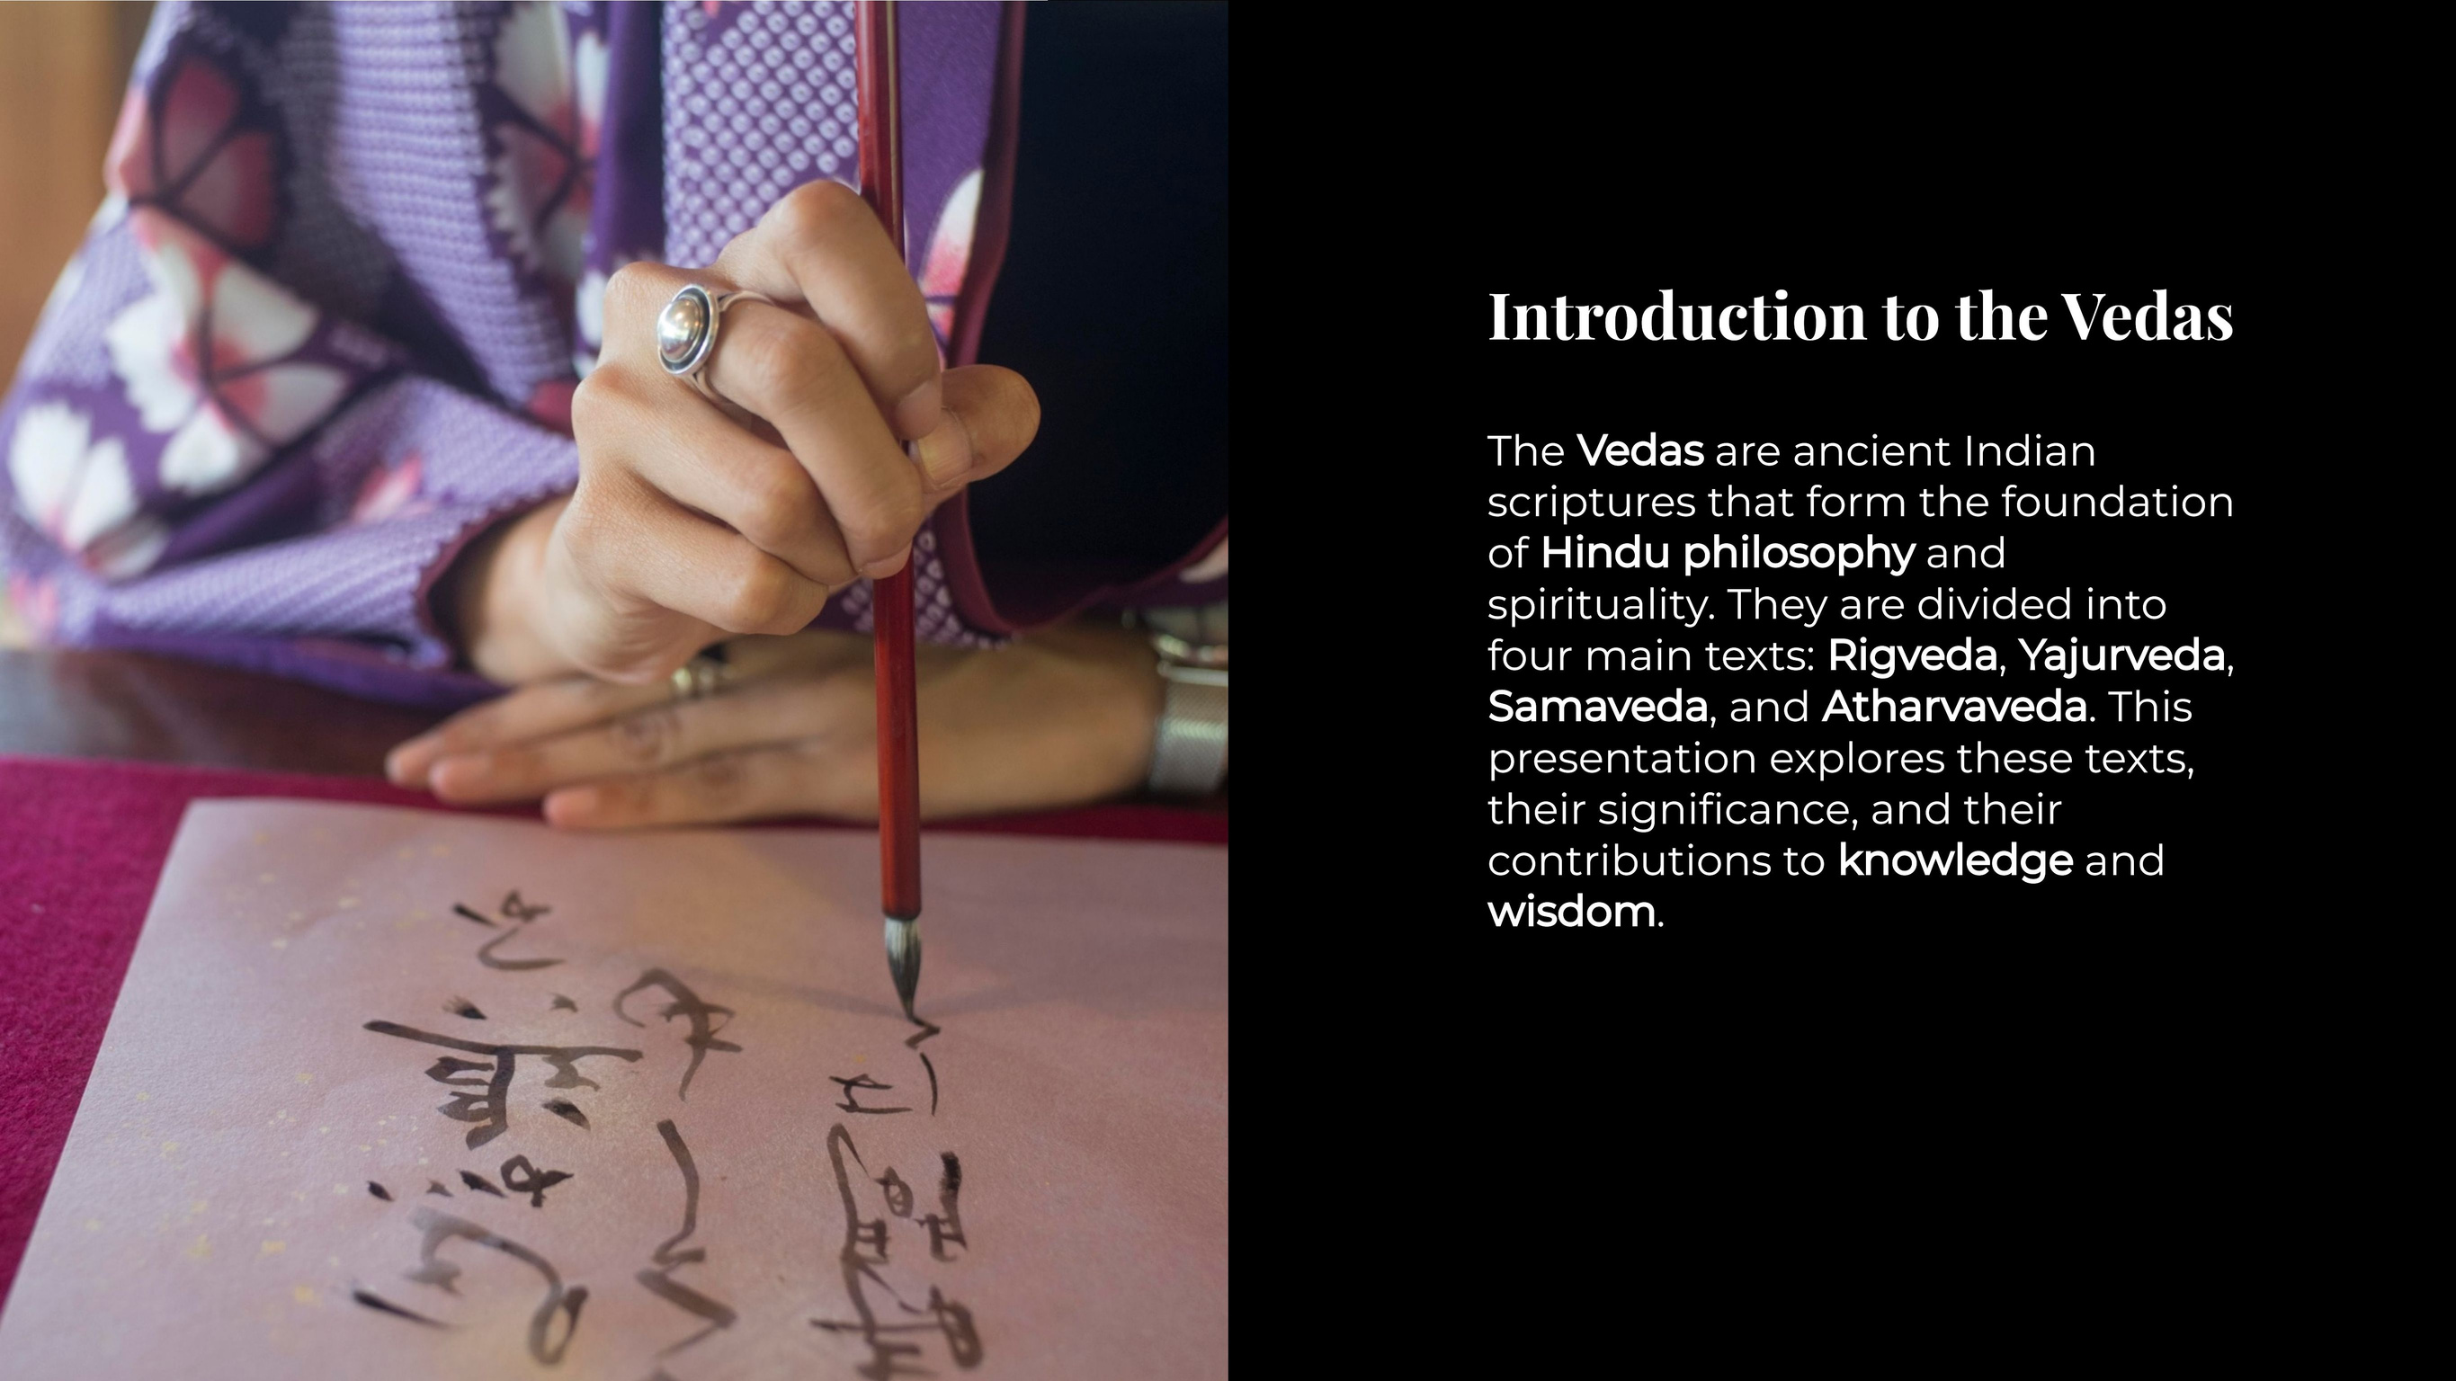

Slide 2
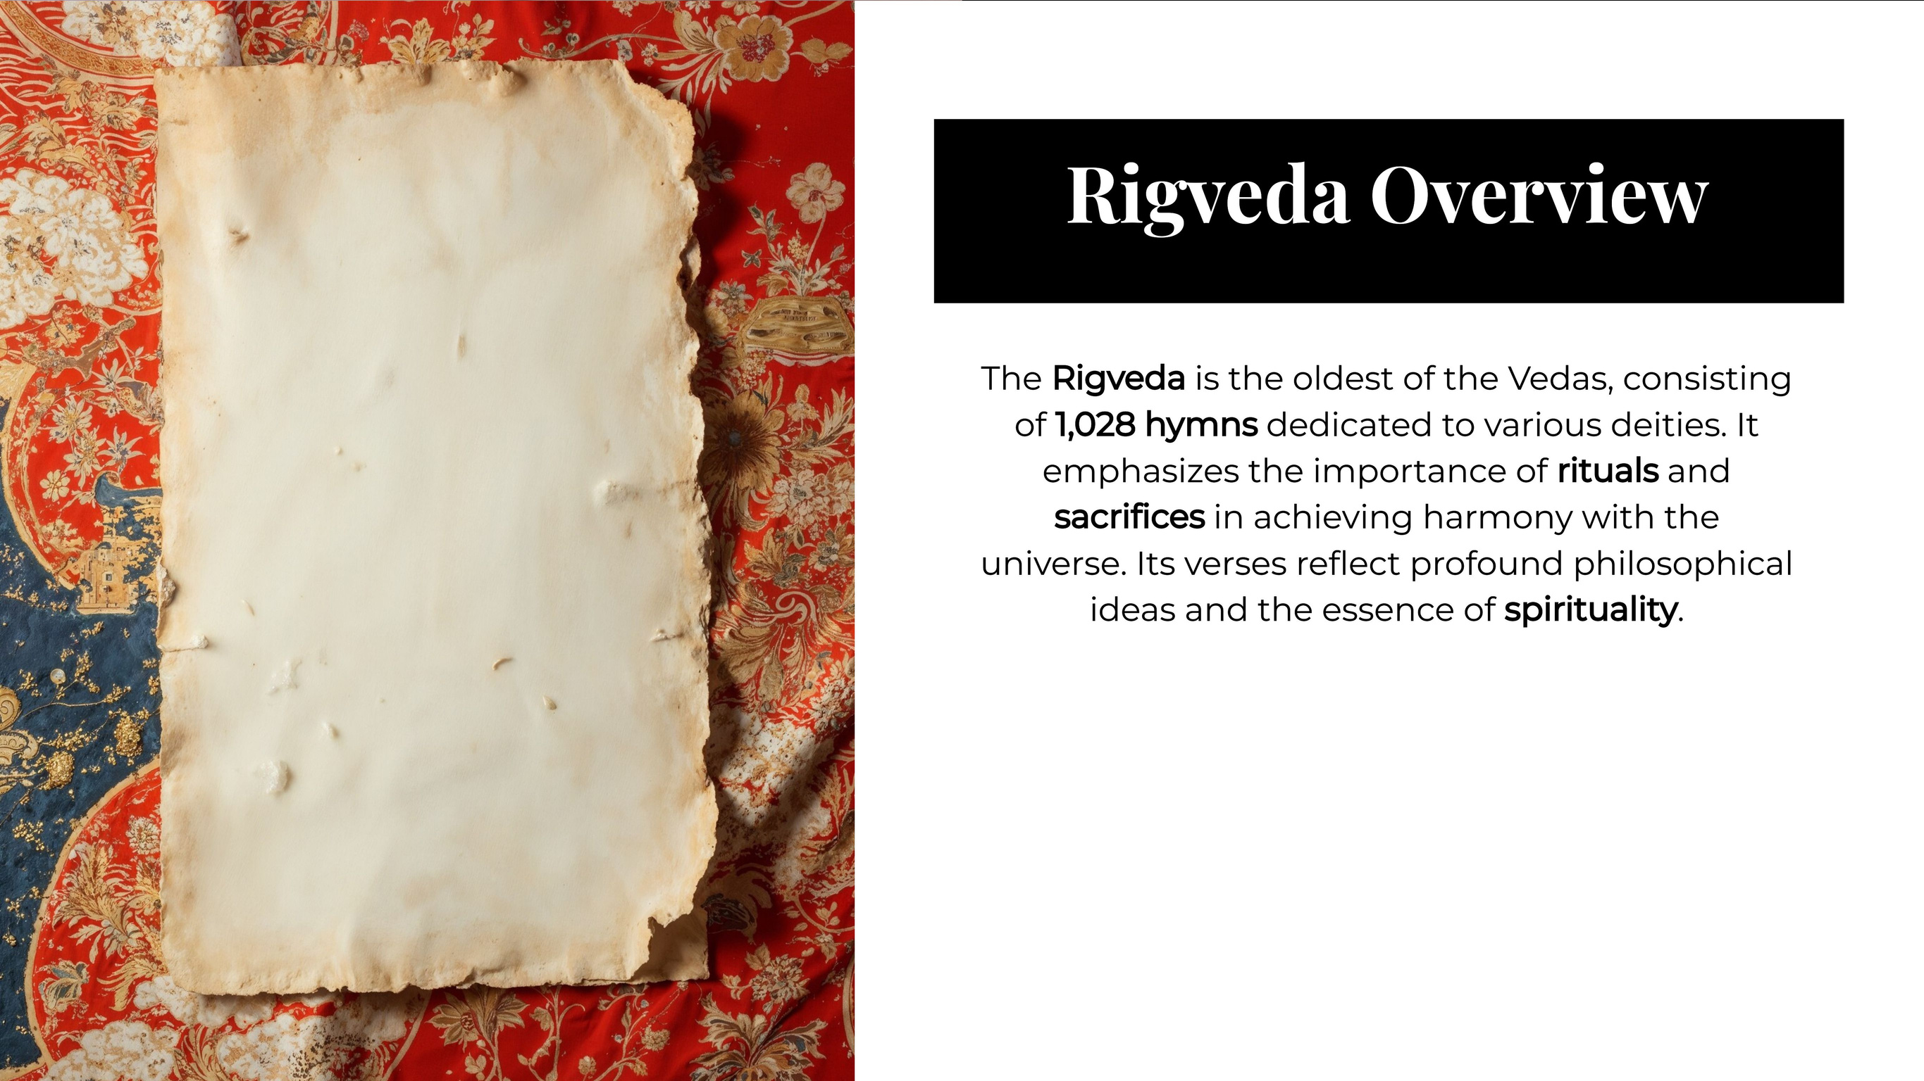
10 Mandalas (Books): Each book consists of hymns praising gods, discussing cosmic principles, and early form of Sanskrit, with poetic meters like Gayatri, Anushtubh, Trishdescribing rituals.
Sanskrit Composition: Written in an tubh, and Jagati.

Slide 3
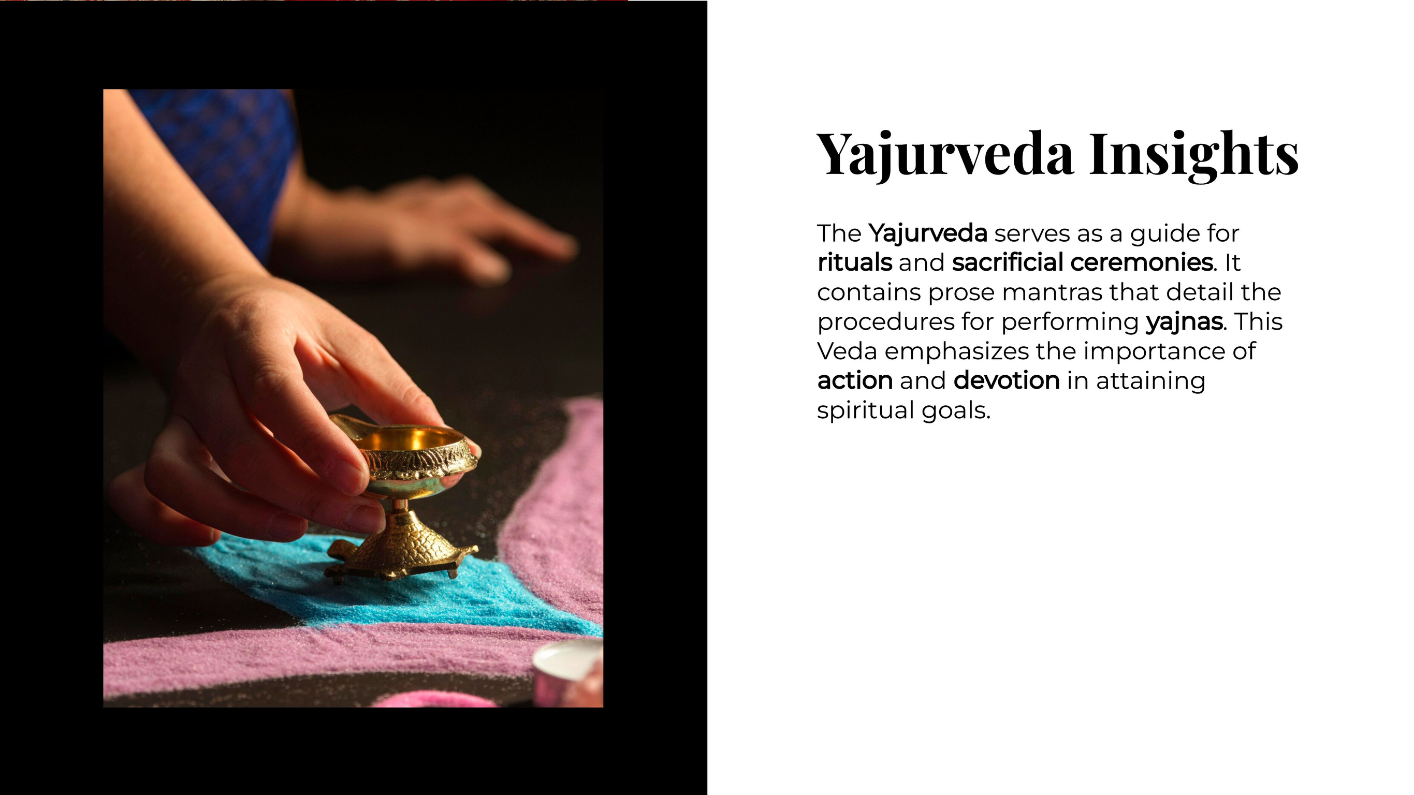
Shukla Yajurveda (White Yajurveda) – Contains only the verses needed for rituals, arranged systematically. The Vajasaneyi Samhita is its main text.
Krishna Yajurveda (Black Yajurveda) – A mix of prose and verses, along with explanations of rituals. The Taittiriya Samhita is a key text.

Slide 4
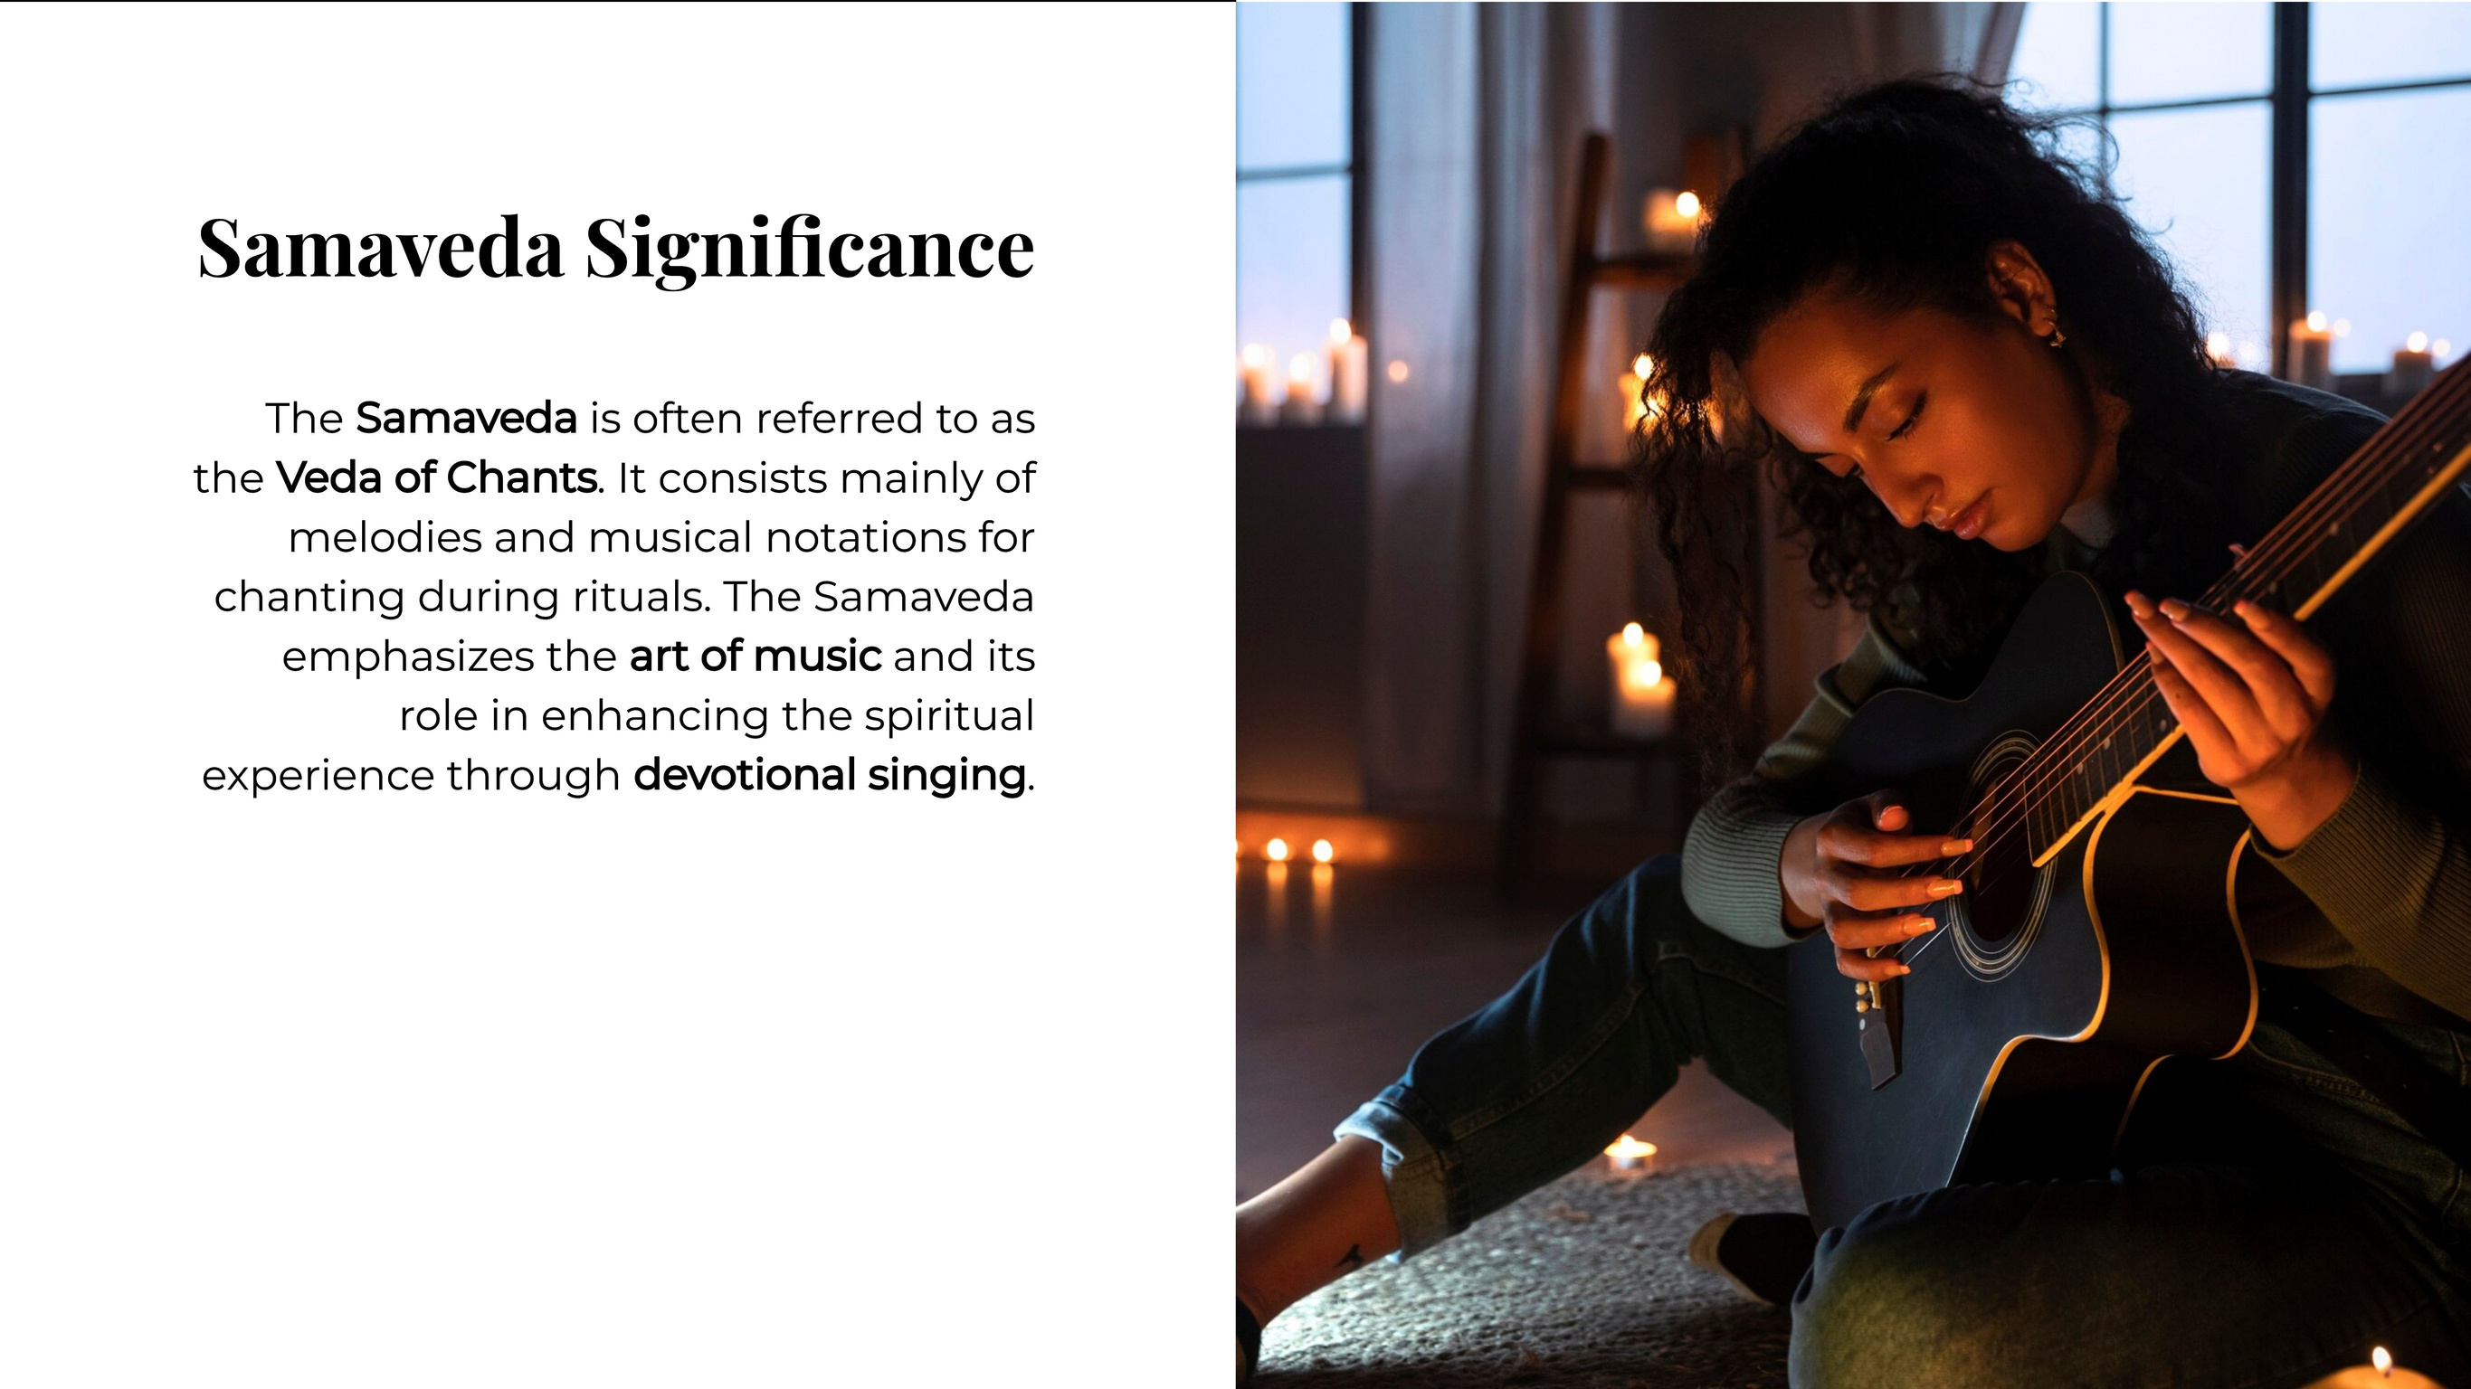
Foundation of Indian Classical Music: The system of ragas and scales in Indian music traces its origins to Sāman chants.
Important in Vedic Rituals: Essential for maintaining the tradition of elaborate Vedic yajñas (sacrificial ceremonies).
Spiritual Power of Sound: Emphasizes the importance of Nāda (sacred sound vibrations) in Hindu spiritual practices.

Slide 5
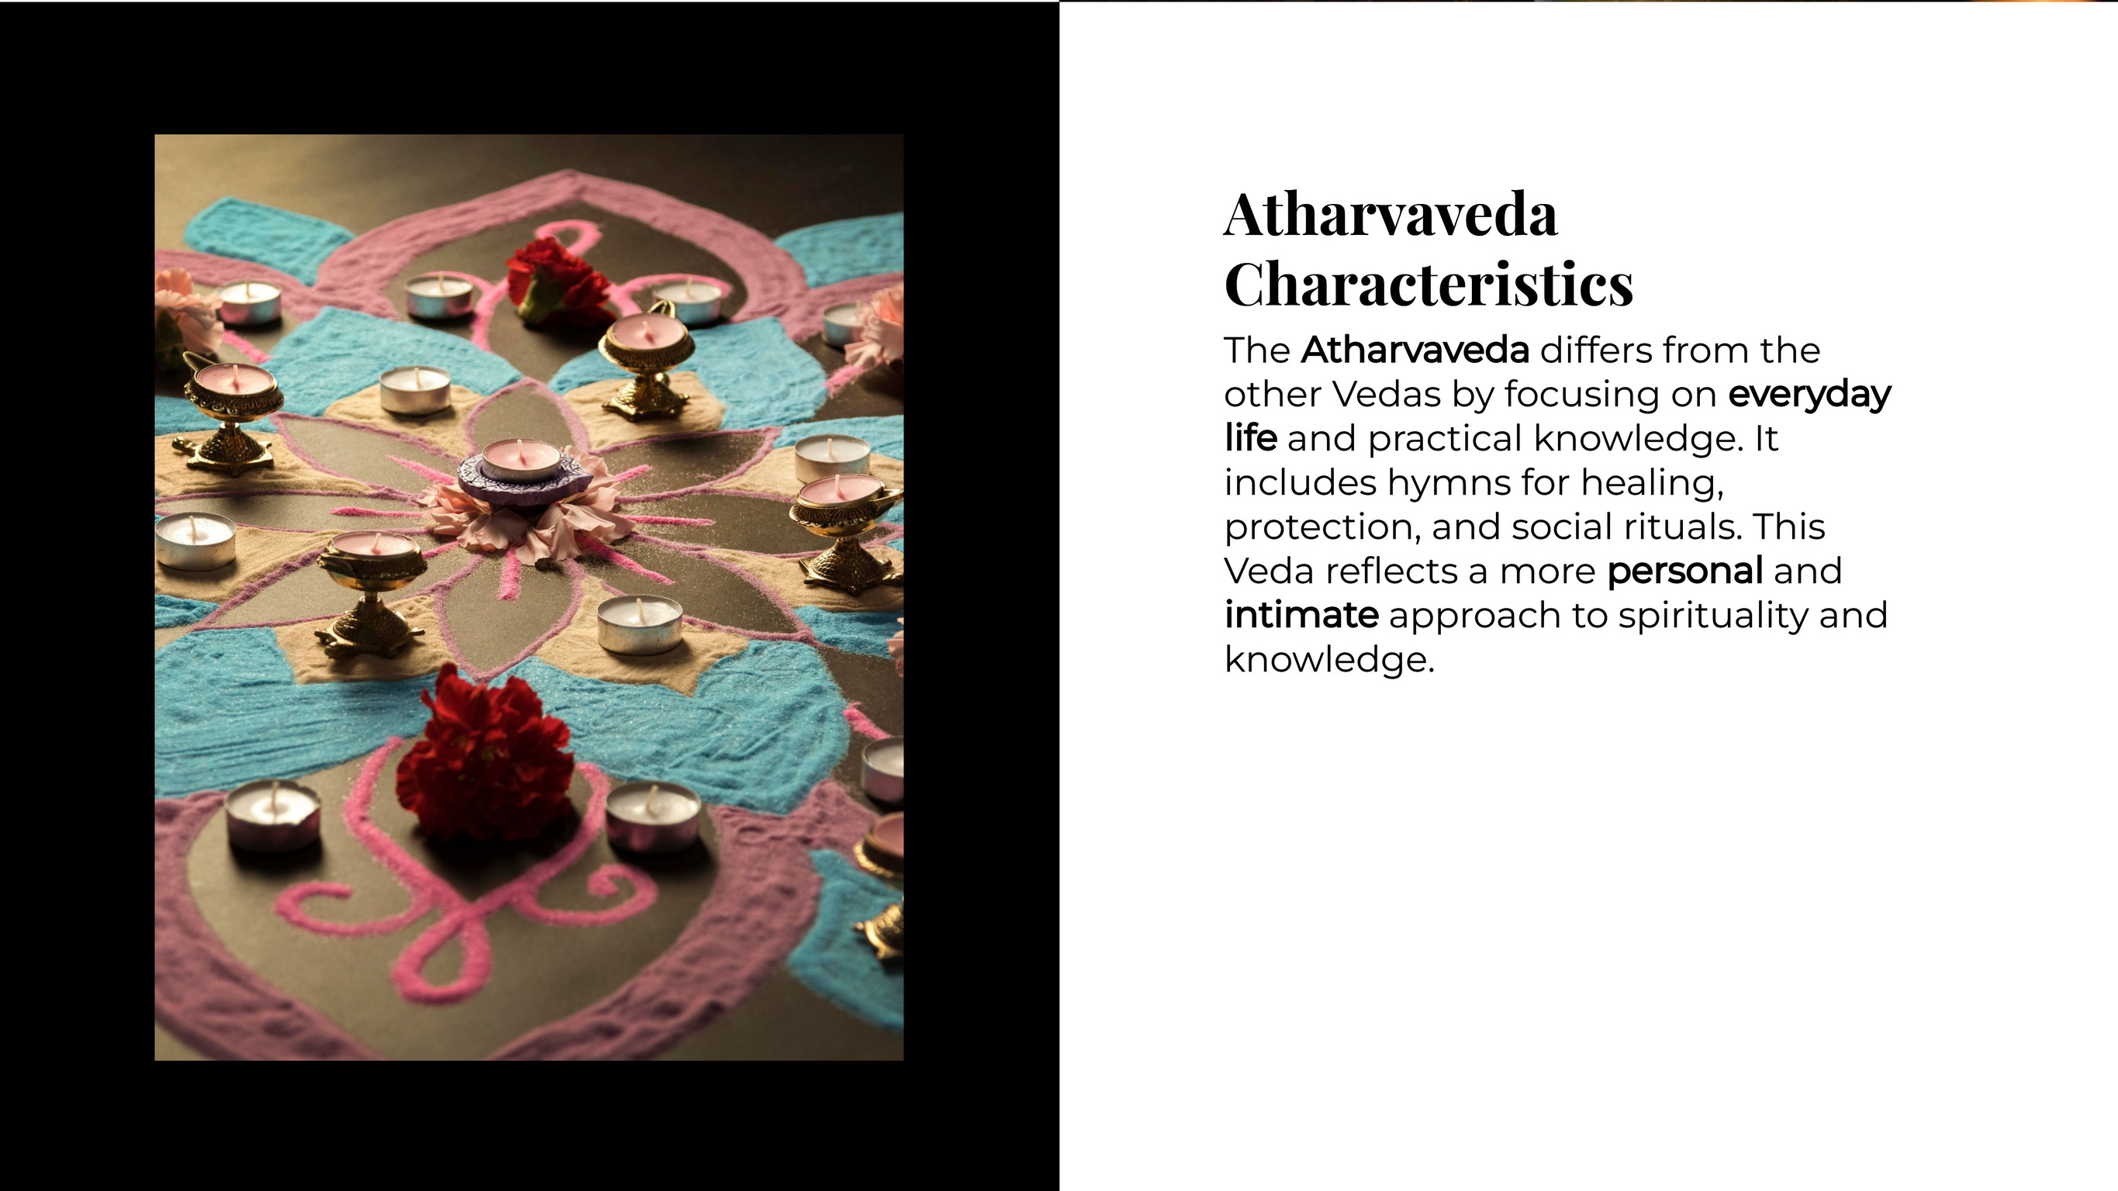
Contains 20 books (kāṇḍas) with around 730 hymns and 6,000 verses.
Written in both metrical and prose forms.
Some hymns are taken from the Rigveda, but many are unique, dealing with healing, protection, and daily life.

Slide 6
Thank you!

